Slide 1
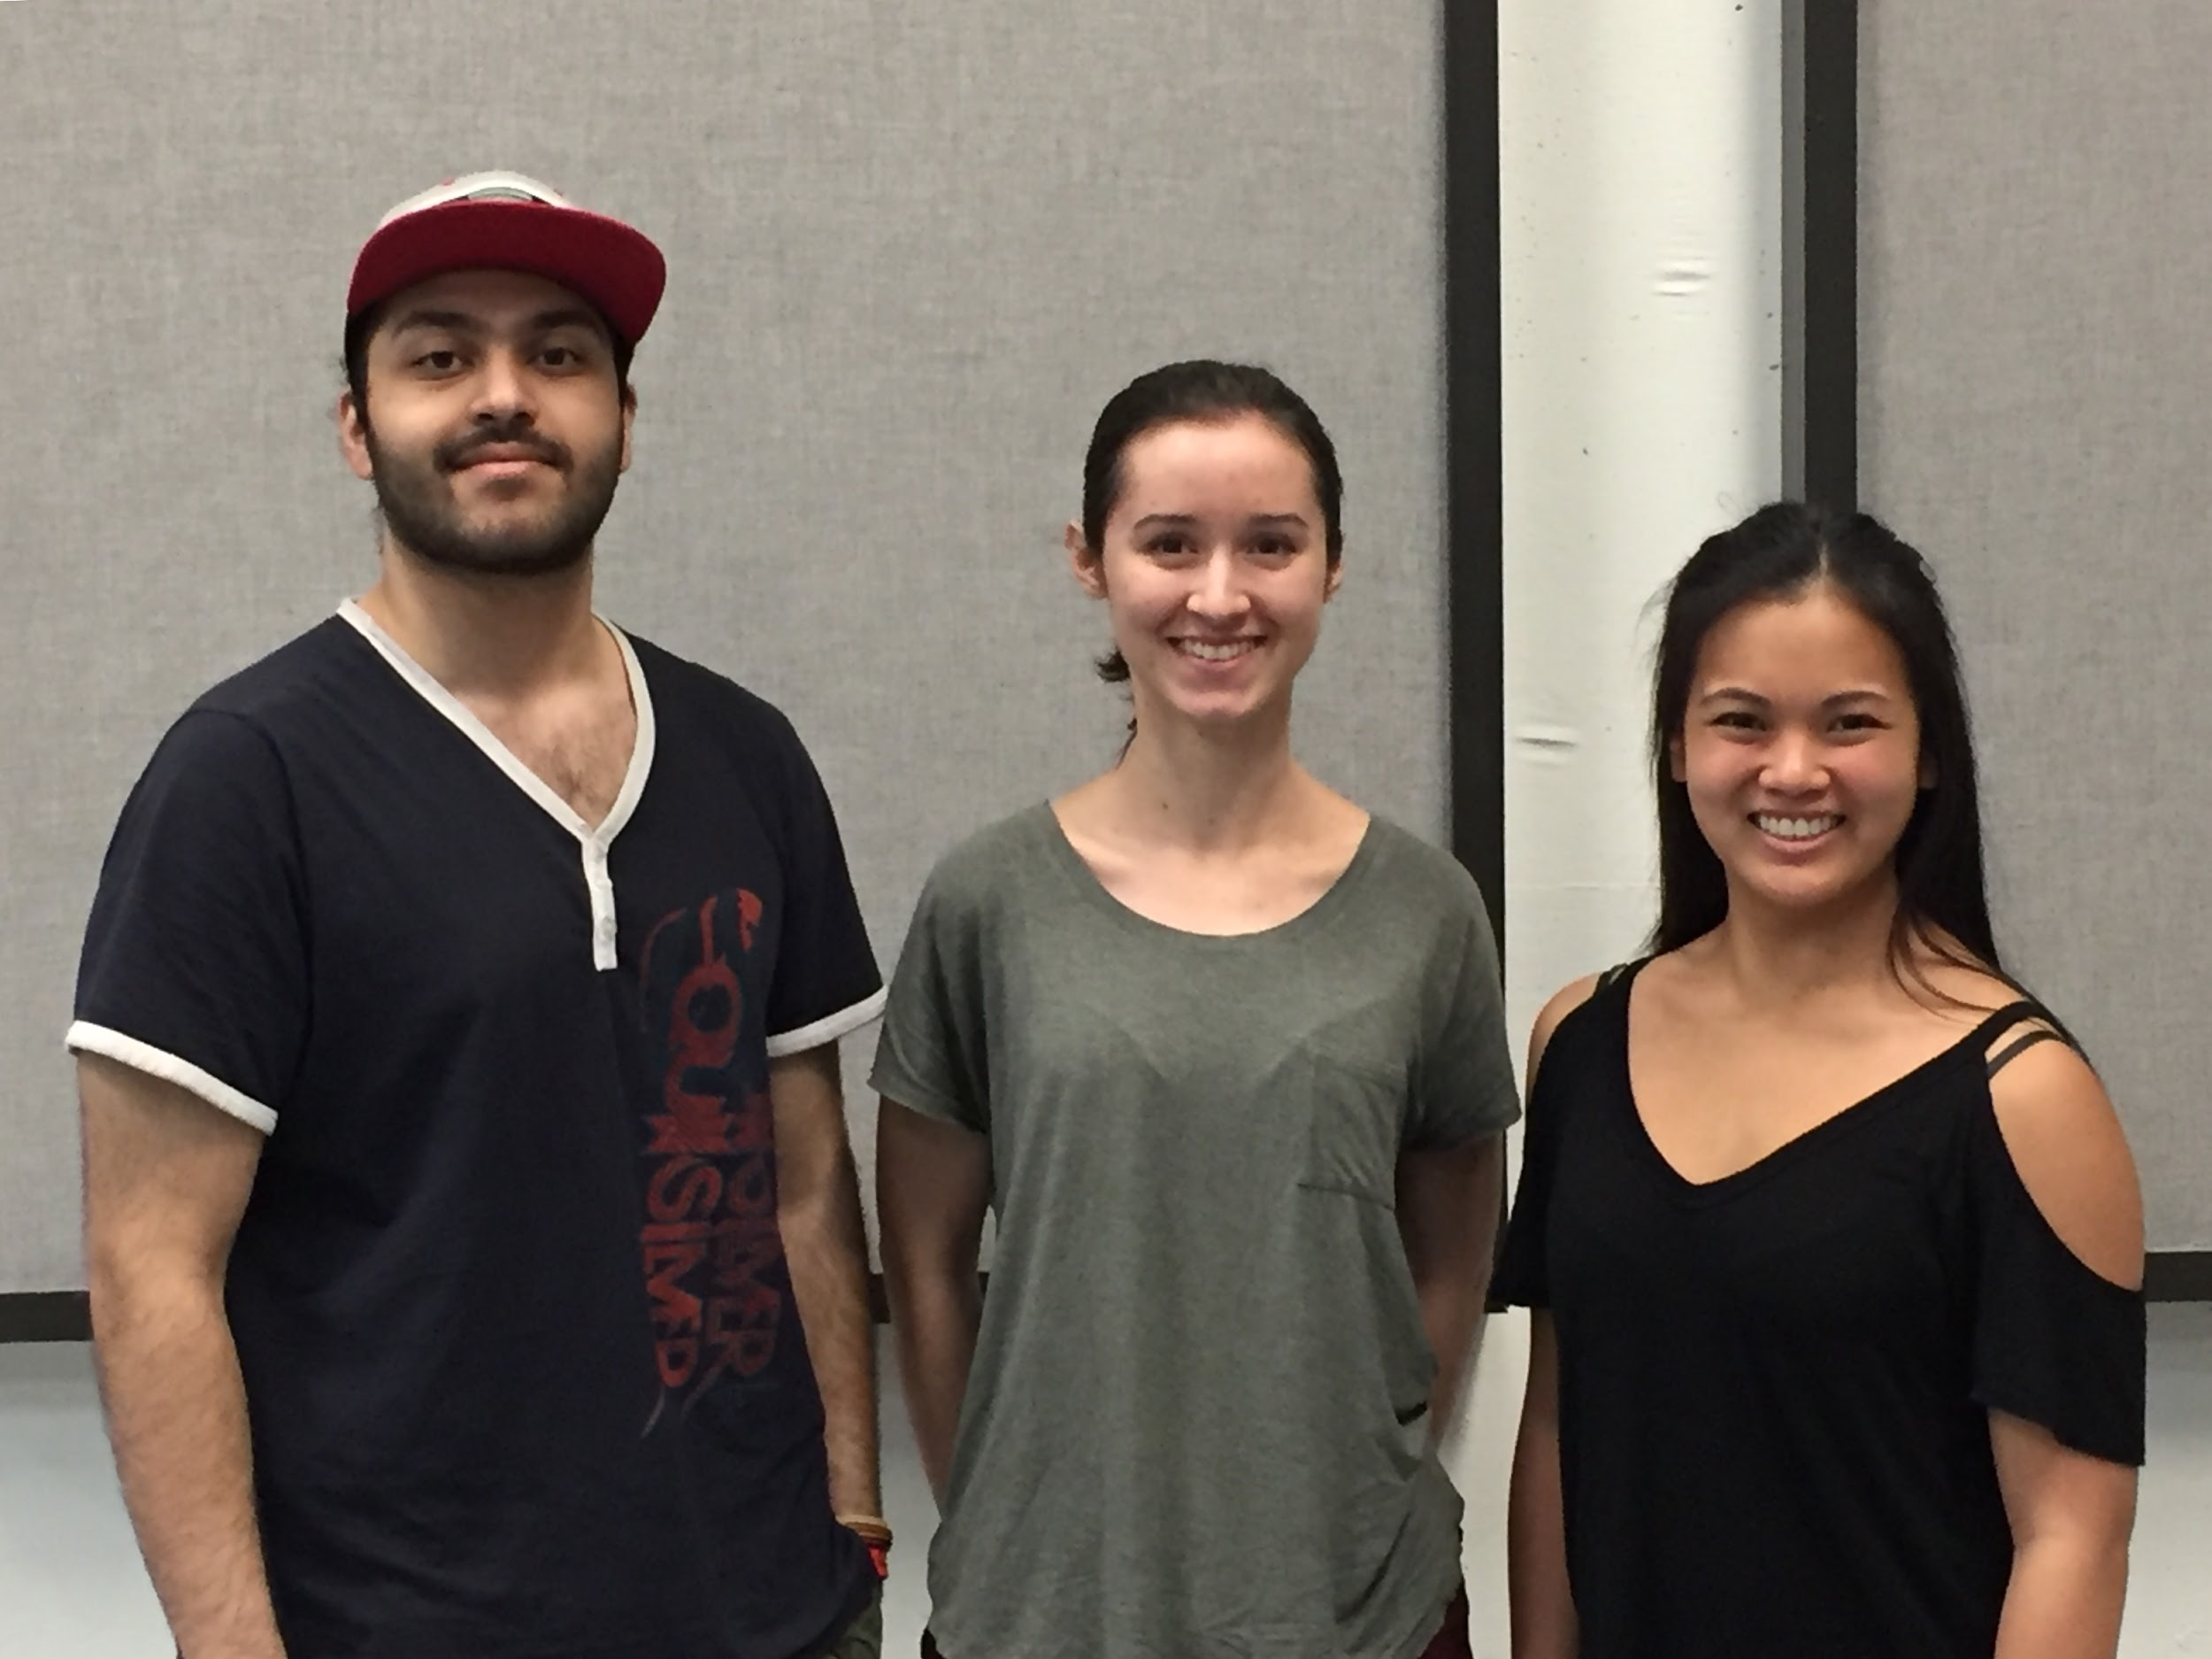
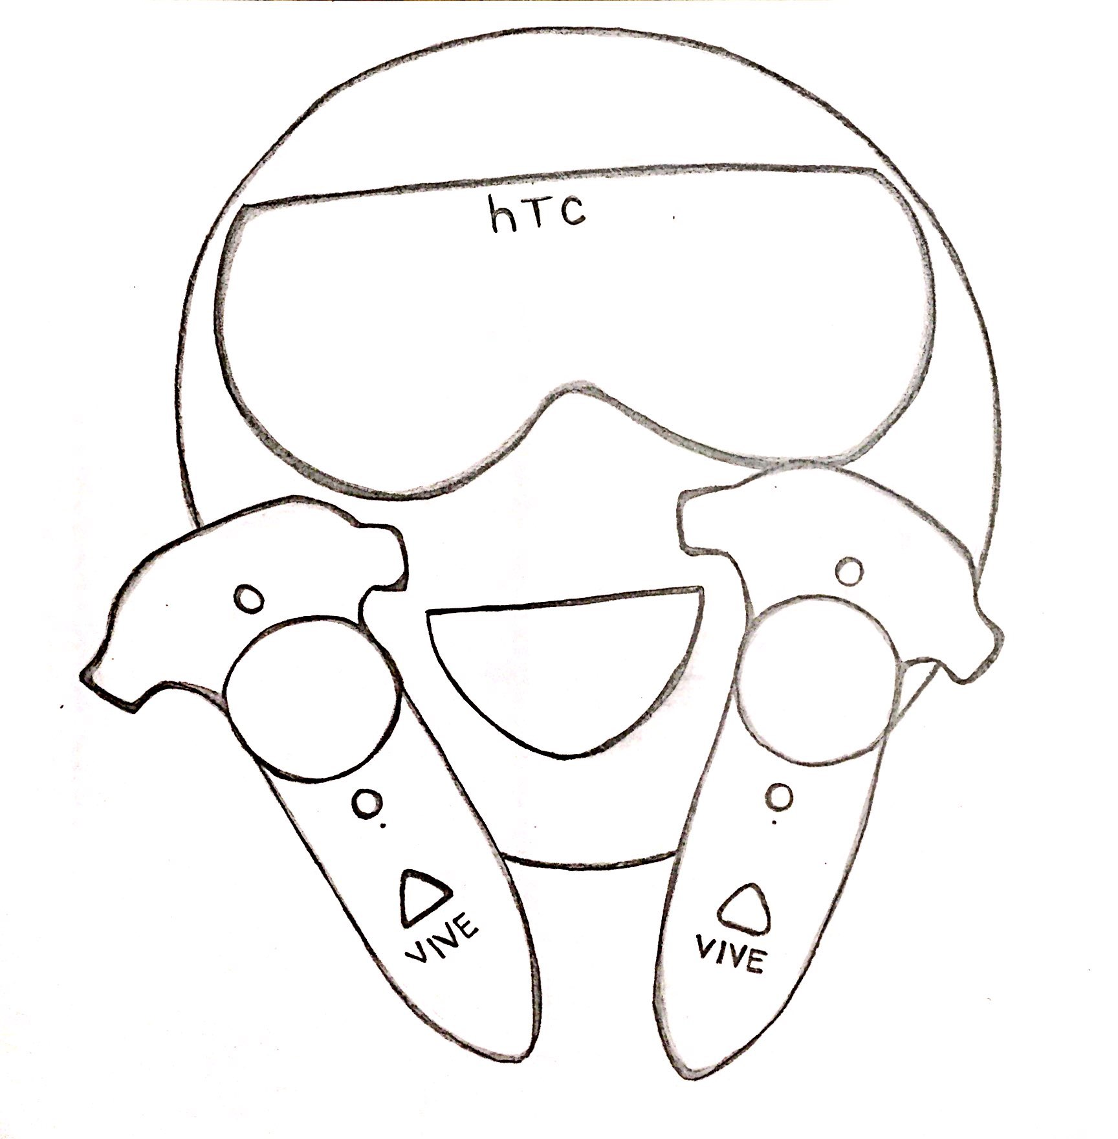
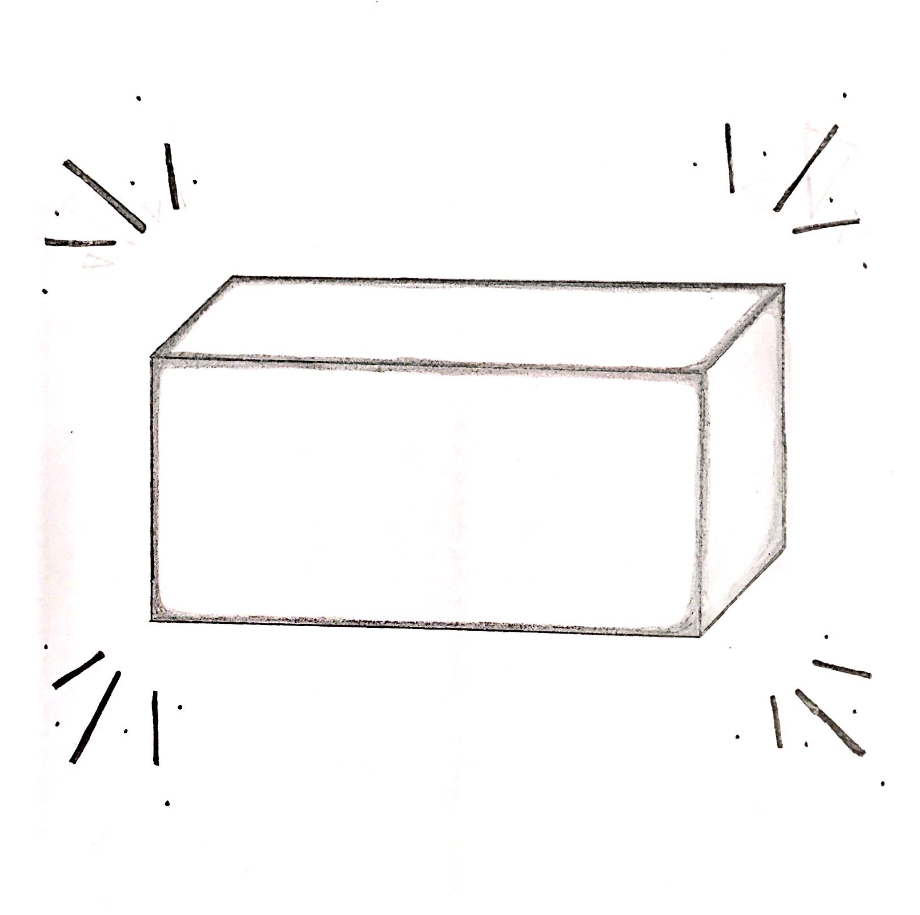
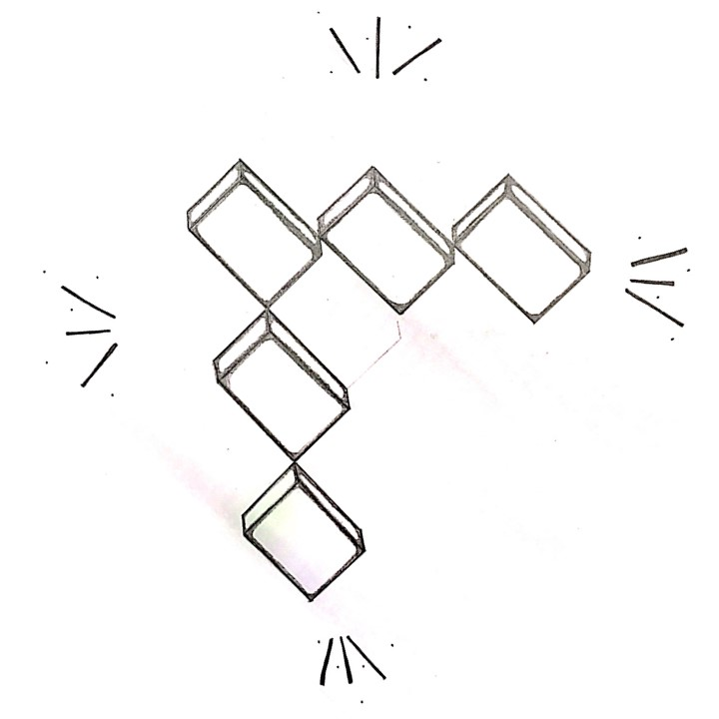
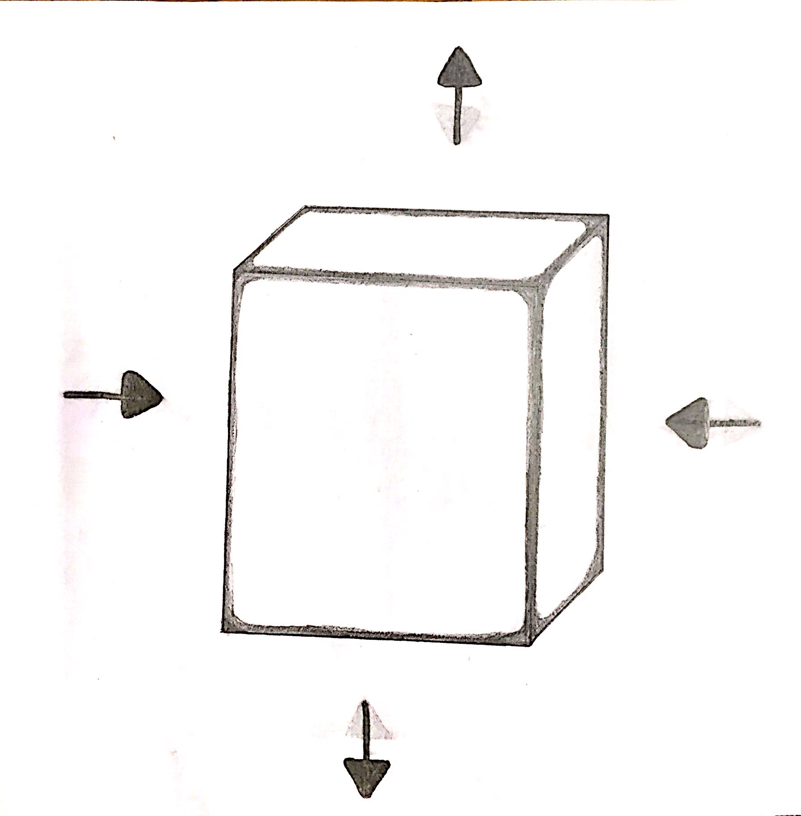
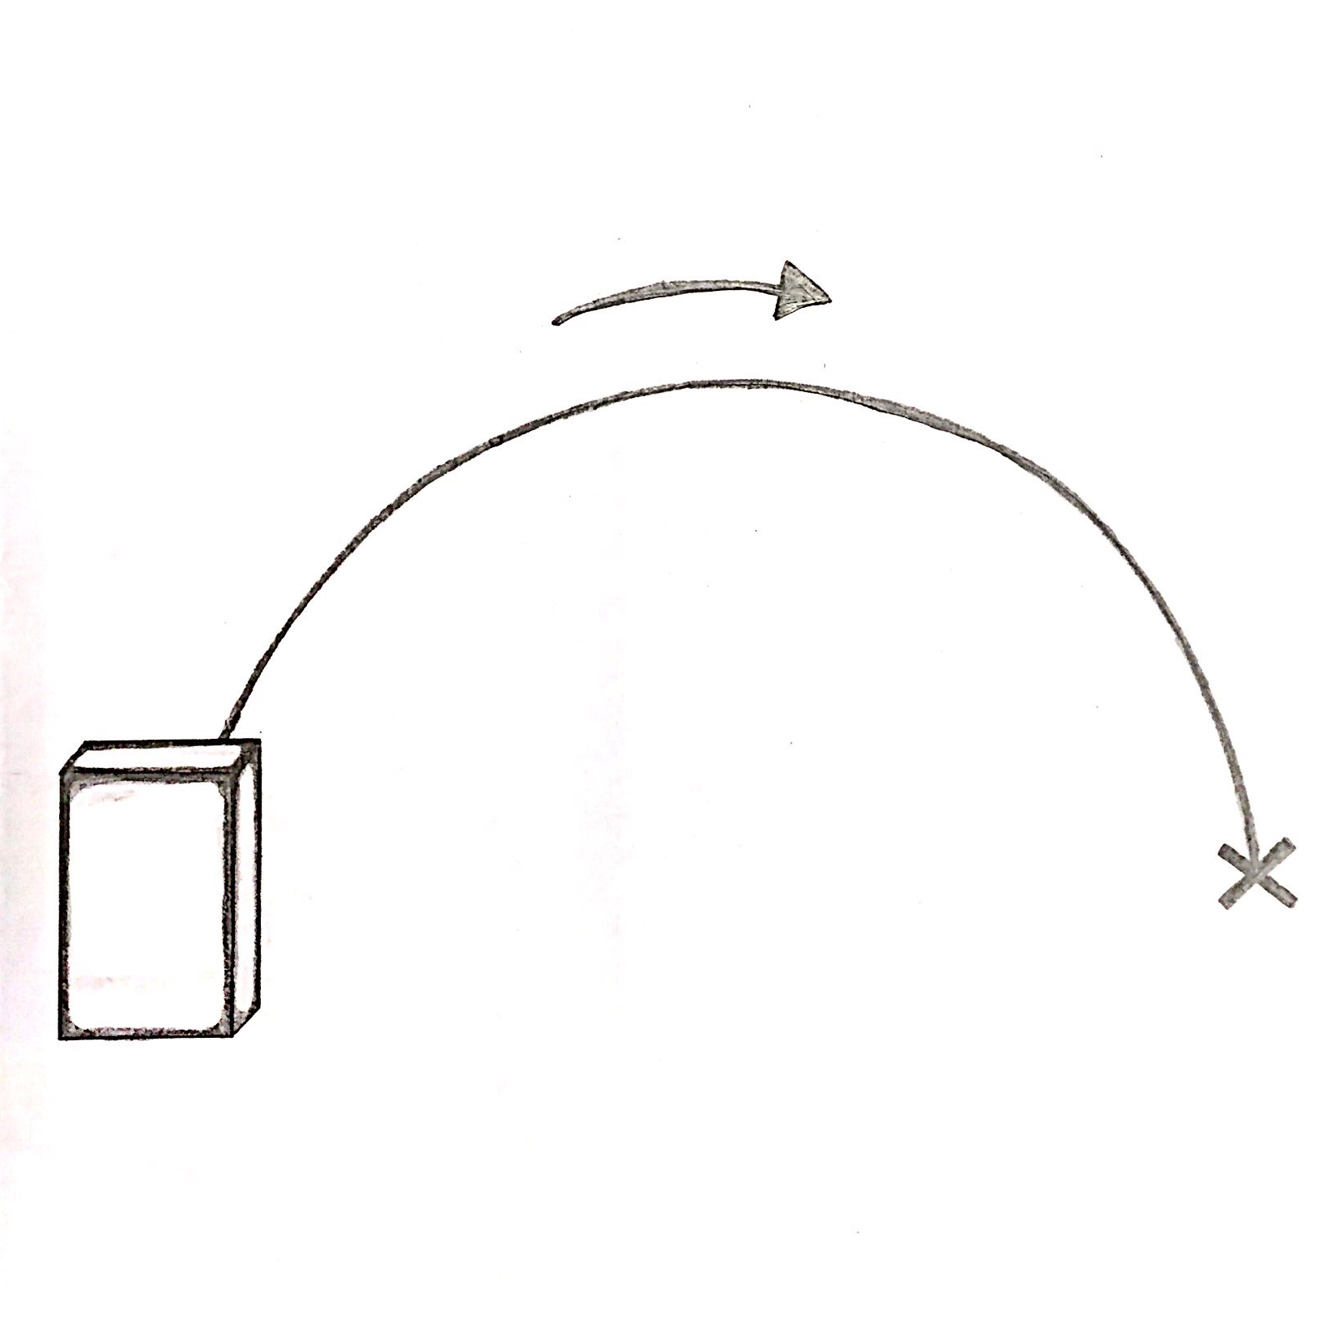
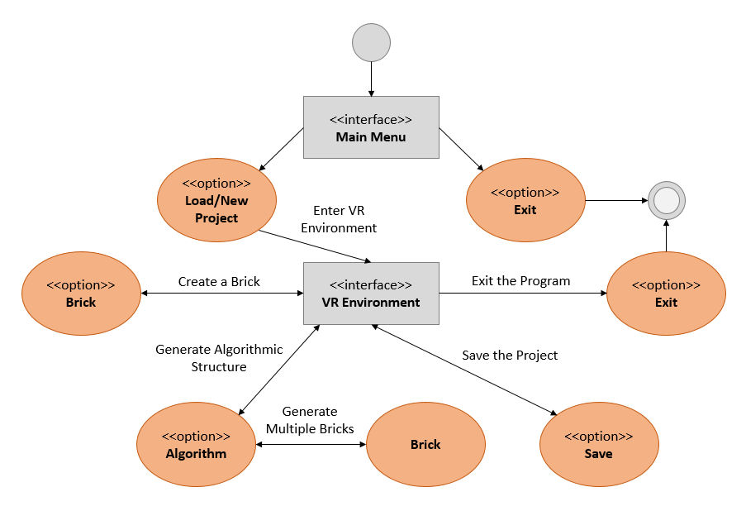
CS61
Story behind the project
Designing In Virtual reality
Generative 3D Design in Architecture
Today’s computer systems utilize many forms of user interfaces that allow users to seamlessly interact with their electronic devices.
Alternative methods of user input and interfaces are becoming more popular, creating a basis for a new generation of user interfaces for architectural and industrial designing.
1 HTC Vive Headset and Controllers
2 Generate 3D Object
(Pictured from Left to Right)
Nabeel Shariff, Hannah Solorzano, Rhea Mae Edwards
Raffaele de Amicis
Associate Professor at Oregon State University, School of Electrical Engineering and Computer Science, focus in research in Computer Graphics and Visualization
raffaele.deamicis@oregonstate.edu
Nabeel Shariff
Computer Science Student focus in Business Entrepreneurship
shariffn@oregonstate.edu
Hannah Solorzano
Computer Science Student focus in Computer Graphics and Game Simulation
solorzah@oregonstate.edu
Rhea Mae Edwards
Computer Science Student focus in Computer Systems
edwardrh@oregonstate.edu
Our Vision
Goal: To improve the efficiency of the interaction between the user and the program via multiple innovative modalities.
The team has used the Unity game engine and Steam VR’s virtual reality plugin to develop the program that puts the power of creation in your hands. Literally.
Simply pick up the HTC Vive controllers and headset to bring your imagination to life!
5 Watch Structure Become [Virtual] Reality!
3 Resize 3D Object
4 Draw Trajectory
designing explanation
What happened in the end?
Power of Unity + Experience of VR + C# =
An intuitive tool to create complex structures out of simple gestures and ideas
1) 3D objects can be spawned by selecting from
the in-game menu via an HTC Vive controller.
2) Objects can be resized, combined, and
altered according to the user’s whim.
3) Curves can also be drawn mathematically,
and then changed into various 3D structures.
4) Save and load objects and environments to
come back to or continually cherish creations.
Usable HTC Vive Compatible VR Program!
Successes:
Program meets basic requirements of generating various 3D objects and creation of trajectories with mathematically curves, along with save and load functionalities.
Limitations:
User is unable to free-draw a curve and delete objects within a scene (program restart is needed), but these additions are in the works for the future.
Notes:
Submitted Version

Slide 2
CS61
Story behind the project
Designing In Virtual reality
Generative 3D Design in Architecture
Today’s computer systems utilize many forms of user interfaces that allow users to seamlessly interact with their electronic devices.
Alternative methods of user input and interfaces are becoming more popular, creating a basis for a new generation of user interfaces for architectural and industrial designing.
1 HTC Vive Headset and Controllers
2 Generate 3D Object
(Pictured from Left to Right)
Nabeel Shariff, Hannah Solorzano, Rhea Mae Edwards
Raffaele de Amicis
Associate Professor at Oregon State University, School of Electrical Engineering and Computer Science raffaele.deamicis@oregonstate.edu
Nabeel Shariff
Computer Science Student focus in Business Entrepreneurship
shariffn@oregonstate.edu
Hannah Solorzano
Computer Science Student focus in Computer Graphics and Game Simulation
solorzah@oregonstate.edu
Rhea Mae Edwards
Computer Science Student focus in Computer Systems
edwardrh@oregonstate.edu
Our Vision
Goal: To improve the efficiency of the interaction between the user and the program via multiple innovative modalities.
The team has used the Unity game engine and Steam VR’s virtual reality plugin to develop the program that puts the power of creation in your hands. Literally.
Simply pick up the HTC Vive controllers and headset to bring your imagination to life!
5 Watch Structure Become [Virtual] Reality!
3 Resize 3D Object
4 Draw Trajectory
designing explanation
What happened in the end?
Power of Unity + Experience of VR + C# =
An intuitive tool to create complex structures out of simple gestures and ideas
1) 3D objects can be spawned by selecting from
the in-game menu via an HTC Vive controller.
2) Objects can be resized, combined, and
altered according to the user’s whim.
3) Curves can also be drawn mathematically,
and then changed into various 3D structures.
4) Save and load objects and environments to
come back to or continually cherish creations.
Usable HTC Vive Compatible VR Program!
Successes:
Program meets basic requirements of generating various 3D objects and creation of trajectories with mathematically curves, along with save and load functionalities.
Limitations:
User is unable to free-draw a curve, within a scene, but this addition is in the works for the future.
Notes:
Dr. De Amicis Revised Version

